Slide 1
Statistical Methods for Decision Making
Probability Distributions

Slide 2
What is Probability Distribution?
In precise terms, a probability distribution is a total listing of the various values the random variable can take along with the corresponding probability of each value. A real life example could be the pattern of distribution of the machine breakdowns in a manufacturing unit.
The random variable in this example would be the various values the machine breakdowns could assume.
The probability corresponding to each value of the breakdown is the relative frequency of occurrence of the breakdown.
The probability distribution for this example is constructed by the actual breakdown pattern observed over a period of time. Statisticians use the term “observed distribution” of breakdowns.

Slide 3
Probability distributions
Discrete
Continuous
Binomial
Poisson
Normal

Slide 4
Binomial Distribution
The Binomial Distribution is a widely used probability distribution of a discrete random variable.
It plays a major role in quality control and quality assurance function. Manufacturing units do use the binomial distribution for defective analysis.
Reducing the number of defectives using the proportion defective control chart (p chart) is an accepted practice in manufacturing organizations.
Binomial distribution is also being used in service organizations like banks, and insurance corporations to get an idea of the proportion customers who are satisfied with the service quality.

Slide 5
Conditions for Applying Binomial Distribution (Bernoulli Process)
Trials are independent and random.
There are fixed number of trials (n trials).
There are only two outcomes of the trial designated as success or failure.
The probability of success is uniform through out the n trials

Slide 6


Binomial Probability Function
The probability of getting x successes out of n trials is indeed the definition of a Binomial Distribution. The Binomial Probability Function is given by the following expression
Where P(x) is the probability of getting x successes in n trials
p is the probability of success, which is the same through out the n trials.
p is the parameter of the Binomial distribution
x can take values 0, 1, 2, ………., n
is the number of ways in which x successes can take place out of n trials

Slide 7
Example for Binomial Distribution
A bank issues credit cards to customers under the scheme of Master Card. Based on the past data, the bank has found out that 60% of all accounts pay on time following the bill. If a sample of 7 accounts is selected at random from the current database, construct the Binomial Probability Distribution of accounts paying on time.

Slide 8
Solution
This problem can be structured as a Bernoulli Process where an account paying on time is taken as success and an account not paying on time is taken as failure. The random variable x represents here an account paying on time, which can take values 0,1,2,3,4,5,6,7. You need to prepare a table containing x and P(x) for all the values of x. Performing calculations using Binomial Probability Function
The best option is to use the Microsoft Excel to calculate the Binomial Probabilities both for individual values and for the cumulative position. This facility is available under the option "Paste Function". The form of the function is: n, p, O or 1) where x is the number of successes, n is the number of trials, and p is the probability of success in each trial. The last term 0 or I performs a logical operation. If you enter 0, the computer returns the individual probability value; if 1 is entered, the computer gives the cumulative probability value
For x = 0, 1, 2, 3, 4, 5, 6, 7 is very tedious

Slide 9
Spreadsheet Showing the Solution

Slide 10
Example problem 2 – binomial distribution
Jones makes an average of 10 calls per day and has a success rate of 75%. Kate makes and average of 16 calls per day but has a success rate of 45%.
What is the probability of the salespersons making 6 sales on any given day?
What is the probability of the salespersons making upto 6 sales on any given day?
What is the probability of the salespersons making atleast 6 sales on any given day?

Slide 11
Binomial Distribution
P(x) = C(n, x) p^{x} (1 – p)^{n-x}
Example:
Jones makes an average of 10 calls per day and has a success rate of 75%. Kate makes and average of 16 calls per day but has a success rate of 45%.
What is the probability of the salespersons making 6 sales on any given day?
For Jones: For Kate:
n = 10 n = 16
x = 6 x = 6
p = 0.75 p = 0.40
=> P(6) = C (10,6) * (0.75)⁶ * (0.25)⁴ = 0.146 => P(6) = C (16,6) * (0.45)⁶ * (0.55)⁴ = 0.168

Slide 12
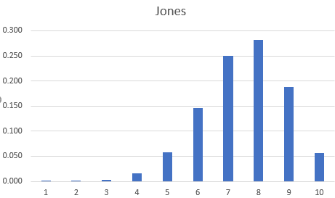
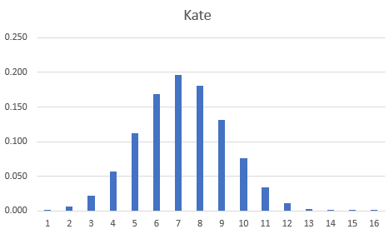
Binomial Distribution: Mean & Std. Dev
Mean Daily Sales : ∑x P(x) = np
Jones: µ = np = 10 * 0.75 = 7.5
Kate: µ = np = 16 * 0.45 = 7.2
Standard deviation in Daily Sales: ∑ (x - µ)² P(x) = npq
Jones: σ = √ (10 * 0.75 * 0.25) = 1.369
Margo: σ = √ (16 * 0.45 * 0.55) = 1.989
n = number of trials
p = probability of success in a trial
q = probability of failure in a trial = 1-p

Slide 13
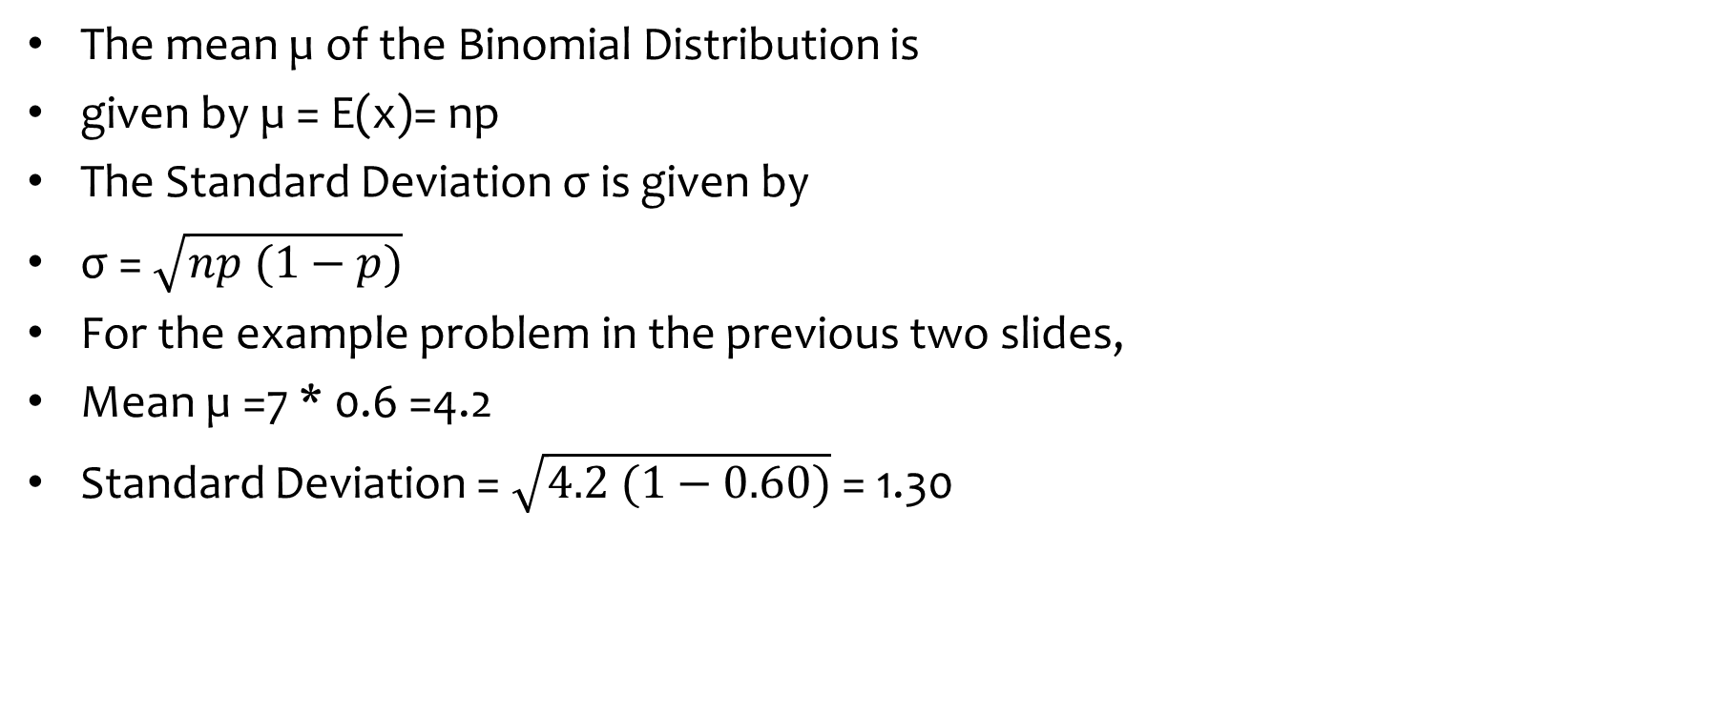
Mean and Standard Deviation of the Binomial Distribution
The mean µ of the Binomial Distribution is
given by µ = E(x)= np
The Standard Deviation σ is given by
σ = $\sqrt{np (1−p)}$
For the example problem in the previous two slides,
Mean µ =7 * 0.6 =4.2
Standard Deviation = $\sqrt{4.2 (1−0.60)}$= 1.30

Slide 14
Poisson Distribution
Poisson Distribution is another discrete distribution which also plays a major role in quality control in the context of reducing the number of defects per standard unit.
Examples include number of defects per item, number of defects per transformer produced, number of defects per 100 m2 of cloth, etc.
Other real life examples would include 1) The number of cars arriving at a highway check post per hour; 2) The number of customers visiting a bank per hour during peak business period.

Slide 15
Poisson Process
The probability of getting an event in a continuous interval such as length, area, time and the like is constant.
The probability of an event occurs in any one interval is independent of the probability of event occurring in any other interval.
The probability of getting more than one event in an interval approaches 0 as the interval becomes smaller.

Slide 16
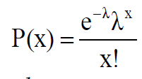
Poisson Probability Function
Poisson Distribution Formula
where
P(x) = Probability of x events in an interval given an idea of λ
λ = Average number of events per unit
e = 2.71828(based on natural logarithm)
x = events per unit which can take values 0, 1, 2, 3,…………..∞
λ is the Parameter of the Poisson Distribution.

Slide 17
Example
If on an average, 6 customers arrive every two minutes at a bank during the busy hours of working, a) what is the probability that exactly four customers arrive in a given minute? b) What is the probability that more than three customers will arrive in a given minute?
6 customers arrive every two minutes. Therefore , 3 customers arrive every minute. That implies my lambda=3
P(X=4)=?
P(X>3)=? Implies 1-P(X< =3)?

Slide 18
Spreadsheet showing Solution
The above spreadsheet shows the formula and solution.

Slide 19
Normal Distribution
The Normal Distribution is the most widely used continuous distribution. It occupies a unique place in the field of statistics. In fact, the entire quality control function that employs the statistical techniques heavily will come to a grinding halt without the use of the normal distribution. The control charts for reducing and stabilizing variation relies on the normal distribution. Process capability studies to meet the customer specifications needs the normal distribution. The whole subject matter inferential statistics is based on the normal distribution. In all management functions including the human side, the observed frequency distributions encountered are all fairly close to the normal distribution when the sample size is reasonably large.

Slide 20
Properties of Normal Distribution
The normal distribution is a continuous distribution looking like a bell. Statisticians use the expression “Bell Shaped Distribution”.
It is a beautiful distribution in which the mean, the median, and the mode are all equal to one another.
It is symmetrical about its mean.
If the tails of the normal distribution are extended, they will run parallel to the horizontal axis without actually touching it. (asymptotic to the x-axis)
The normal distribution has two parameters namely the mean µ and the standard deviation σ

Slide 21
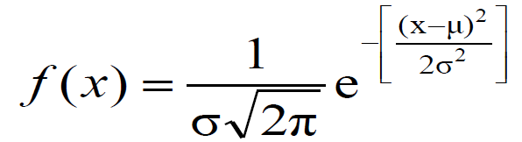
Normal Probability Density Function
In the usual notation, the probability density function of the normal distribution is given below:
x is a continuous normal random variable with -∞ < x < ∞.

Slide 22

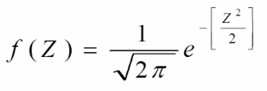
Standard Normal Distribution
The Standard Normal Variable is defined as follows:
Please note that Z is a pure number independent of the unit of measurement. The random variable Z follows a normal distribution with mean=0 and standard deviation =1.

Slide 23
Example Problem
The mean weight of a morning breakfast cereal pack is 0.295 kg with a standard deviation of 0.025 kg. The random variable weight of the pack follows a normal distribution.
a)What is the probability that the pack weighs less than 0.280 kg?
b)What is the probability that the pack weighs more than 0.350 kg?
c)What is the probability that the pack weighs between 0.260 kg to 0.340 kg?

Slide 24
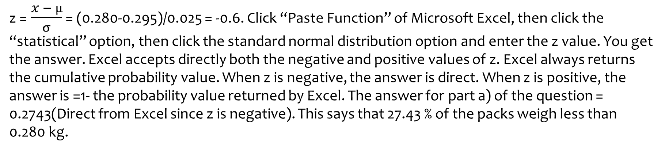
Solution-a)
z = $\frac{x − µ}{σ}$ = (0.280-0.295)/0.025 = -0.6. Click “Paste Function” of Microsoft Excel, then click the “statistical” option, then click the standard normal distribution option and enter the z value. You get the answer. Excel accepts directly both the negative and positive values of z. Excel always returns the cumulative probability value. When z is negative, the answer is direct. When z is positive, the answer is =1- the probability value returned by Excel. The answer for part a) of the question = 0.2743(Direct from Excel since z is negative). This says that 27.43 % of the packs weigh less than 0.280 kg.

Slide 25
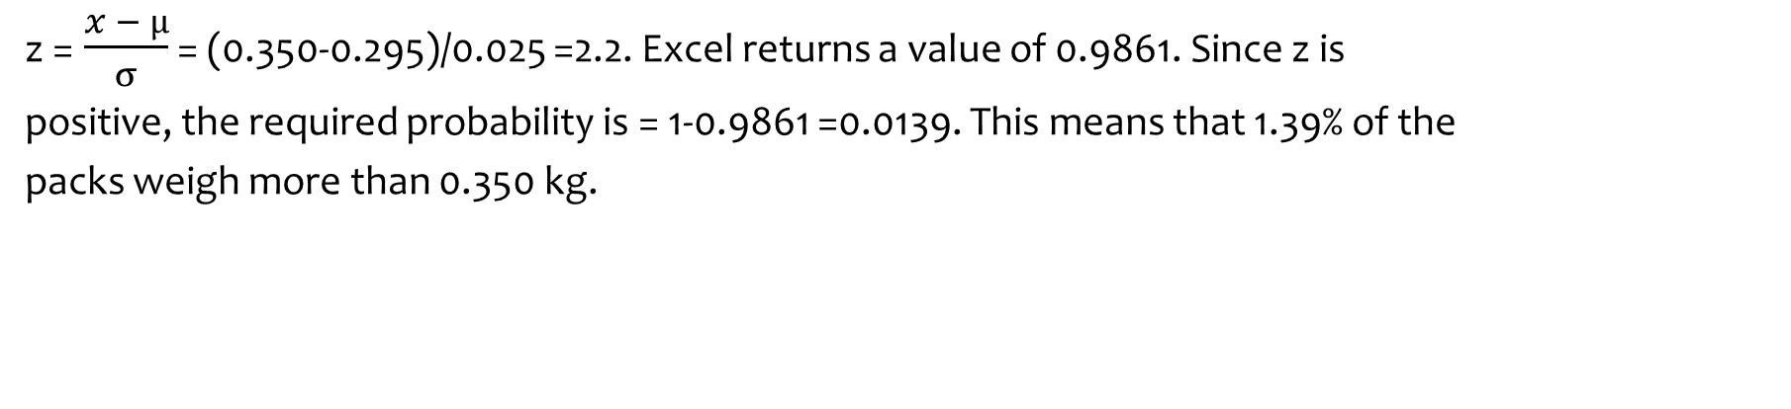
Solution-b)
z = $\frac{x − µ}{σ}$ = (0.350-0.295)/0.025 =2.2. Excel returns a value of 0.9861. Since z is
positive, the required probability is = 1-0.9861 =0.0139. This means that 1.39% of the
packs weigh more than 0.350 kg.

Slide 26
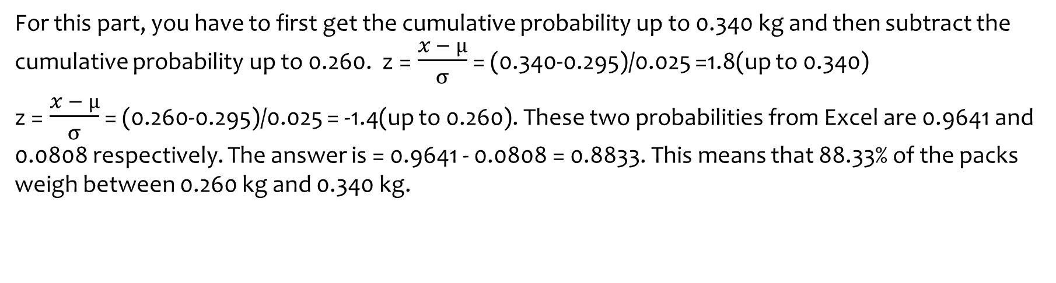
Solution-c)
For this part, you have to first get the cumulative probability up to 0.340 kg and then subtract the cumulative probability up to 0.260. z = $\frac{x − µ}{σ}$ = (0.340-0.295)/0.025 =1.8(up to 0.340)
z = $\frac{x − µ}{σ}$ = (0.260-0.295)/0.025 = -1.4(up to 0.260). These two probabilities from Excel are 0.9641 and 0.0808 respectively. The answer is = 0.9641 - 0.0808 = 0.8833. This means that 88.33% of the packs weigh between 0.260 kg and 0.340 kg.

Slide 27
Example 2
A company produces a bolt of length 10mm for its customers The bolts produces are normally distributed with average length of 10.01mm & standard deviation 0.06mm
(a) What is the probability that the bolt produced will be longer than 10.2 mm
(b) The sales team is negotiating with a new customer who has more stringent quality requirements. The new customer requires bolts shall be between 9.9 and 10.15 mm. What is the probability that a bolt produces by the current process will be acceptable to the new customer
(c) What is the length for which 99% of bolts produced will be less that the length?

Slide 28
Solution a)
The value required is greater than 10.2 (i.e. right tail)
The answer is 0.00077 = 0.077% probability

Slide 29
Solution b)
Since the probability between 10.15 and 9.90 is needed, we need to subtract the cumulative probability of 9.90 from the cumulative probability of 10.15
Answer: 0.9568 i.e. 95.68% chance of meeting customer criteria.

Slide 30
Solution c)
In this question the probability is given and we are required to calculate the value below which (to left of which) 99% of area lies.
Answer: 99% of bolts will be smaller than 10.14958 mm

